Slide 1
Power BI Embedded
FSI CSU SWARM

Slide 2
Hands-On Module

Slide 3
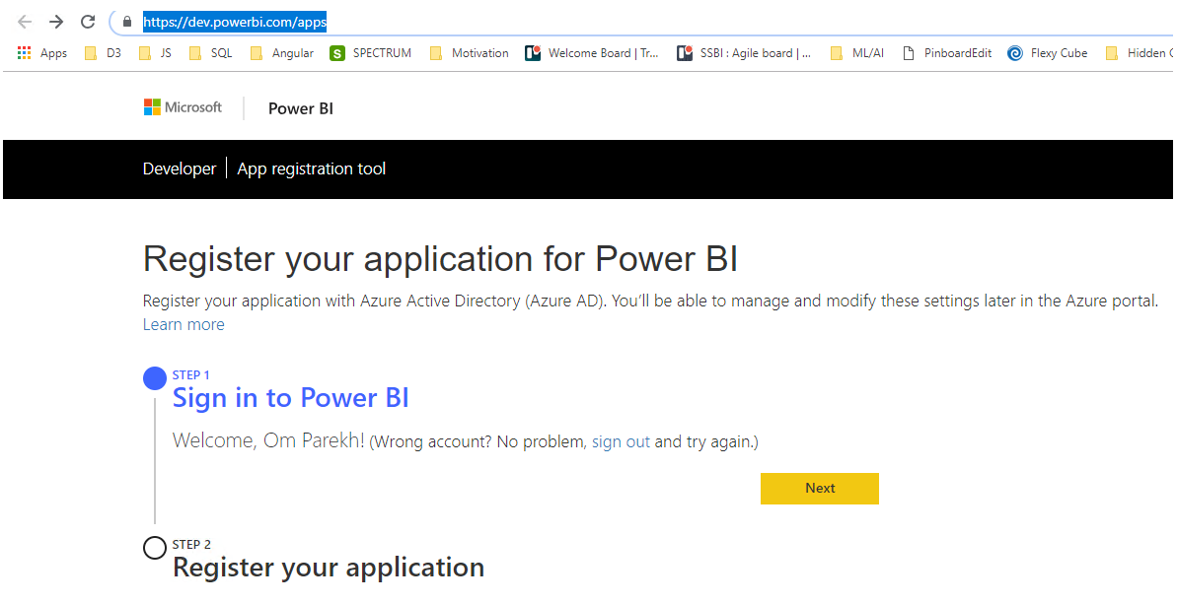
Registered your app for Power BI
Open below URL and Sign-in using Power BI Pro credentials
https://dev.powerbi.com/apps

Slide 4
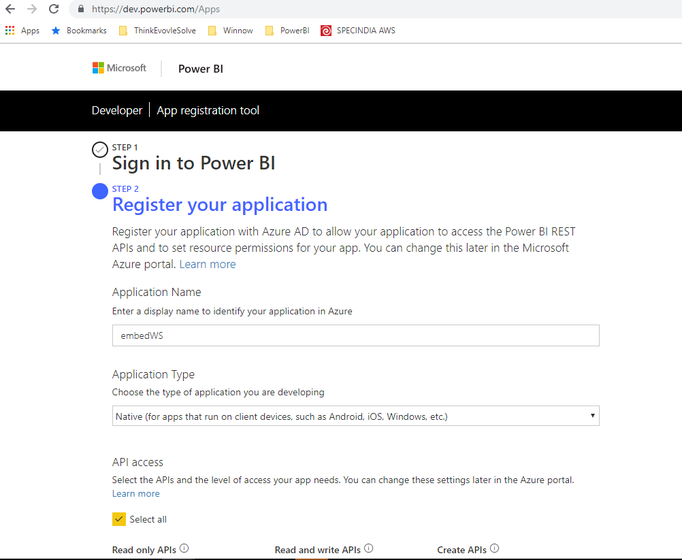
Registered your app for Power BI
Registered App (Step 2)
Please remember Application name, Client Id
Example Client ID : 7114bf2f-8aad-49ad-8a7c-2e80e9b6fbba

Slide 5
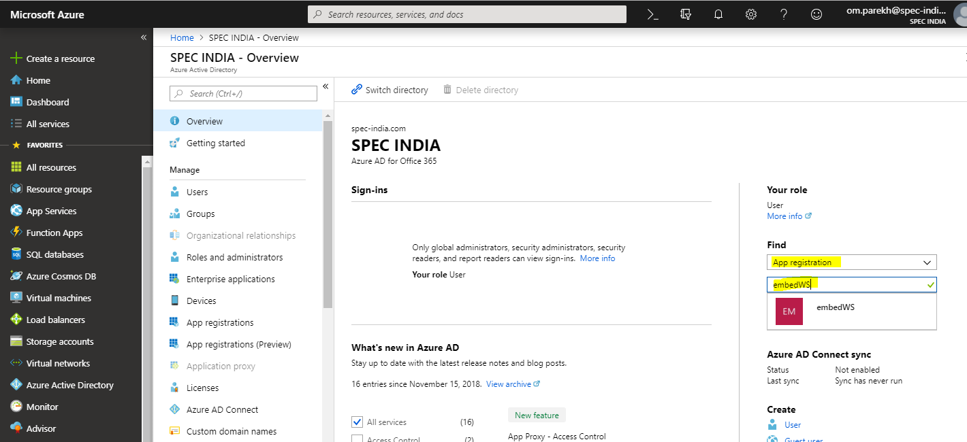
Registered your app for Power BI
Open Azure portal using the same Power BI Pro account and registered your app (Azure Active Directory)
Goto Setting -> Required Permission -> Grant Permission (select All)

Slide 6
Power BI
Go to Power BI App (app.powerbi.com)

Slide 7
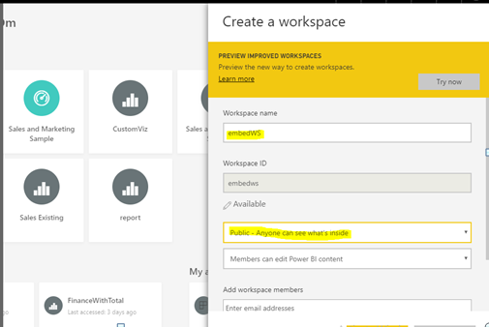
Power BI
Create Workspace
Note : Workspace name should match with application name we defined in azure portal.

Slide 8
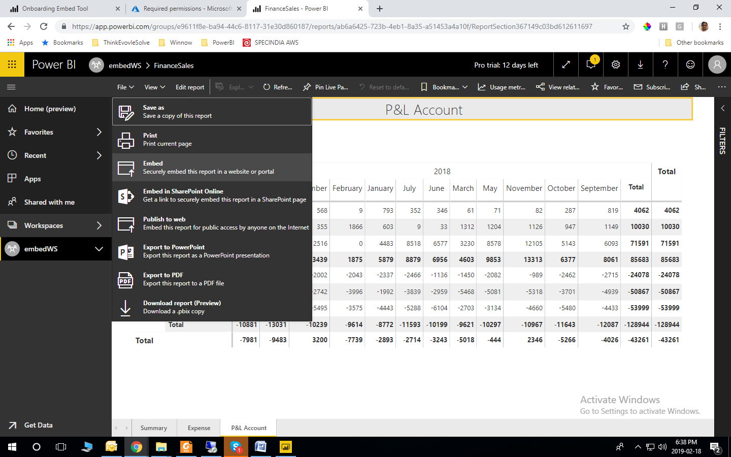
Power BI
Published the Power BI report in workspace we just created in above steps.
Open Power BI Report and click on File->Embed

Slide 9
Power BI
Copy URL from the popup window.
Embed URL : https://app.powerbi.com/reportEmbed?reportId=ab6a6425-723b-4eb1-8a35-a51453a4a10f&groupId=e9611f8e-ba94-44c6-8117-31e30d860187
Report Id = ab6a6425-723b-4eb1-8a35-a51453a4a10f
Group Id = e9611f8e-ba94-44c6-8117-31e30d860187
Please note embed url, group id and report id

Slide 10
REST API
Call REST API to open power BI report securely

Slide 11
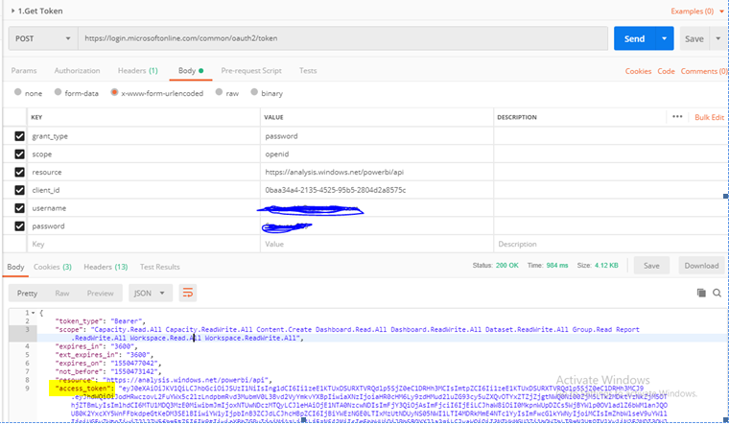
REST API Part
Call GetTocken REST API with header and body
https://login.microsoftonline.com/common/oauth2/token
Header
Content-Type = application/x-www-form-urlencoded
Remember Access Token from result

Slide 12
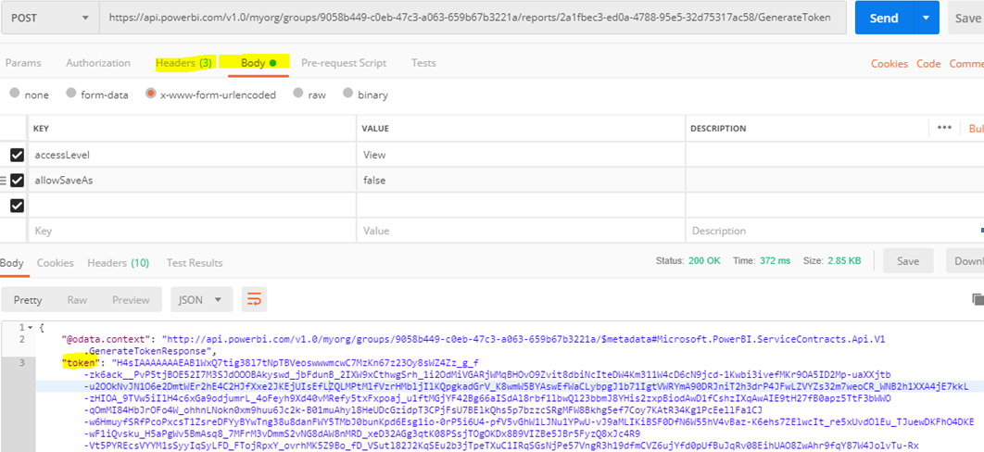
REST API Part
Generate embed token using below REST API
https://api.powerbi.com/v1.0/myorg/groups/<<GROUP ID>>/reports/<<REPORT ID>>/GenerateToken
Header
Authorization = Bearer <<Access Tocken>>
Content-Type = application/x-www-form-urlencoded
Accept=application/json
BODY
accessLevel = View
allowSaveAs=false
Remember Token from result [it is embed token]

Slide 13
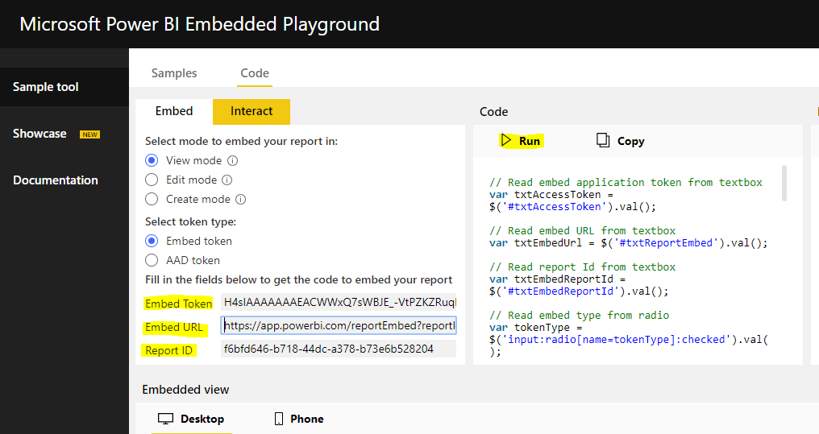
Attached Power BI Report in App
We have following items
Embed Token
Report Id
Group Id
Call Power BI Report using Microsoft Utilities
https://microsoft.github.io/PowerBI-JavaScript/demo/v2-demo/index.html

